Slide 1

Unit 4 Protection and Security
By
Amandeep Kaur

Slide 2
Protection and Security
Protection means securing the data of one process from another. A process P1 must not be able to write into the address space of process P2.
Security means safeguarding the data from external threats like virus, worms, etc. Operating system deploy different tools from these. One of the most common tool is firewall.

Slide 3
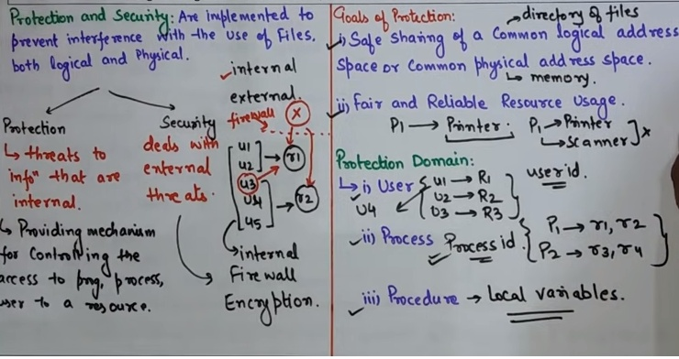
Protection and Security

Slide 4
Operating systems are exposed to a variety of cyberthreats, such as viruses, worms, Trojan horses, ransomware, and other malware, if sufficient security measures are not taken.
Why is operating system security important? Or Need of Security?

Slide 5
Security Vulnerability like Buffer overflow, Trapdoors, Backdoors, cache poisoning etc.
A vulnerability is effectively an error in the code or the logic of operation within the OS or the application software. Because today's OSs and applications are very complex and include a lot of functionality, it's difficult for a vendor's (salesman/programmer) development team to create software that contains no errors.
Security Vulnerability

Slide 6
Also known as a buffer overrun, buffer overflow occurs when the amount of data in the buffer exceeds its storage capacity. That extra data overflows into adjacent memory locations and corrupts or overwrites the data in those locations.
Buffer Overflow

Slide 7

Trap Door (aka secret door)
A trap door is a method of gaining access to information or OS features that are normally beyond a user's access authority. The distinguishing feature of a trap door is that it is intentionally hidden and used only when needed.

Slide 8
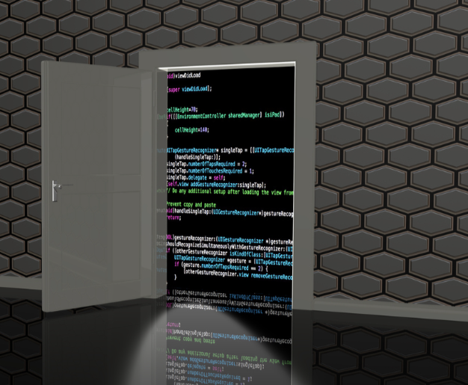
A backdoor attack is a way to access a computer system or encrypted data that bypasses the system's customary security mechanisms.
A developer may create a backdoor so that an application, operating system (OS) or data can be accessed for troubleshooting or other purposes.
Backdoor

Slide 9
DNS cache poisoning is the act of entering false information into a DNS cache, so that DNS queries return an incorrect response and users are directed to the wrong websites.
DNS cache poisoning is also known as DNS spoofing.
Cache poisoning

Slide 10
Password-based authentication is a method that requires the user to enter their credentials — username and password — in order to confirm their identity.
Once credentials are entered, they are compared against the stored credentials in the system's database, and the user is only granted access if the credentials match.
Authentication-Password based Authentication

Slide 11

Password management is defined as a system that facilitates a simple, secure way to store passwords and access them quickly when required. Today, password management is a critical part of the IT policy of most organizations.
Password Management

Slide 12

Operating system communication can be secured using various measures and mechanisms, such as encryption, authentication, authorization, and auditing.
Each security method has its own benefit and challenge, depending on the type, level, and risk of the communication.
Secure Communication

Slide 13
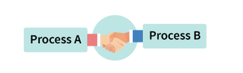
Sometimes processes want to communicate among themselves i.e., they want to send some message to each other. These processes can be on the same system or might be running on different systems. An operating system provides two mechanism to handle this inter process communication(IPC): shared-memory and message-passing.
Communication(IPC)

Slide 14

Application Security
Application Security –
Virus, Program Threats, Goals of protection, Principles of protection, Domain of protection, Access matrix, Implementation of access matrix, System and network threats, Examples of attacks

Slide 15

VIRUS
(Vital Information Resources Under Seize)
Any type of malware (malicious software) that can result in operational issues, data theft, file deletion, data loss, and system damage is referred to as a virus. OR
A computer virus is a computer program or a piece of code that is loaded onto your computer without your knowledge and run against your consent. Virus has a property to replicate itself and spread itself from one computer to another computer. It can affect the data files, boot sector of hard drive etc. when its replication succeeds. The affected area is said infected.

Slide 16
There are two types of threats:
Internal (Protection): Internal user try to access the resources to the other user within a system.
External (Security): External user try to access the resources.
Eg. Firewall work as a security layer to provide security from the unauthorized user.
Program Threats

Slide 17
Protection is a technique for protecting data and processes from harmful or intentional infiltration. It contains protection policies either established by itself, set by management or imposed individually by programmers to ensure that their programs are protected to the greatest extent possible.
Goals of Protection

Slide 18
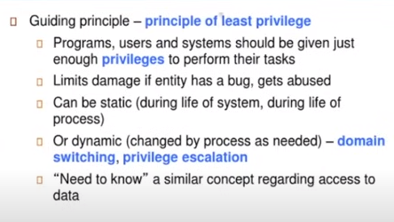
Principles of protection

Slide 19
Association between Process and Domain
When processes have the necessary access rights, they can switch from one domain to another. It could be of two types, as shown below.
1. Fixed or Static
In a fixed association, all access rights could be given to processes at the start. However, the results in a large number of access rights for domain switching. As a result, a technique of changing the domain's contents is found dynamically.
2. Changing or dynamic
A process may switch dynamically and creating a new domain in the process.

Slide 20
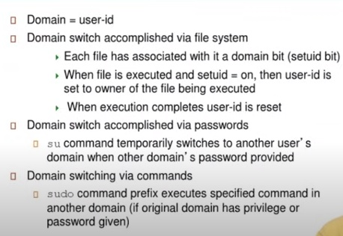
Domain Implementation

Slide 21
AM(Access Matrix): It provides the structure approach to managing the permissions and enforcing security policies.
It provide a concise representation of the permissions granted to subjects(users/processes,entities) to access object(files,resrc. data) within OS.
It play a crucial role in Access Control mechanism within OS.
Access Matrix
(AM)

Slide 22
A security model of a computer system’s defensive state is called the "Access Matrix."
An access matrix is used to provide the permissions for every process running in the domain for each object.
In OS, the access matrix is displayed as a two-dimensional matrix with rows denoting domains and columns denoting objects.
Each matrix cell corresponds to a particular set of access rights given to domain processes. This shows that each entry access (i, j) defines the group of operations that a process running in domain Di may perform on object Oj.
The access matrix carries out policy judgments, including those regarding whether rights, such as reading, writing, and execution, should be included in the (i, j)th entry. (This policy is usually decided by the operating system).
AM

Slide 23
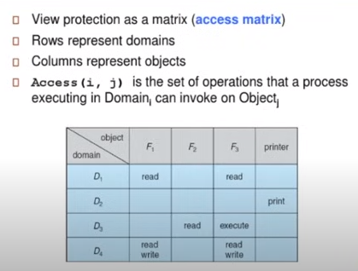
Implementation of Access Matrix

Slide 24
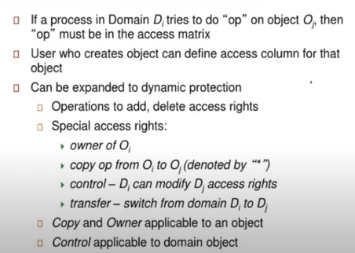
Implementation of Access Matrix

Slide 25
Implementation of Access Matrix in OSAs already mentioned, the operating system’s access matrix probably takes up a lot of memory and is extremely sparse. Therefore, implementing an access matrix for access control directly would be storage inefficient.
To lessen the inefficiencies, the access matrix might be separated into rows or columns. By removing null values, the columns and rows can be compacted to improve efficiency.
These decomposition techniques can be used to create four common access matrix implementations:
Global Table
Capability Lists for Domains
Access Lists for Objects
Lock and key Method
Implementation of Access Matrix

Slide 26
Various Methods Used to Implement the Access Matrix in OSSome widely used methods for implementing the access matrix in os are as follows:
1. Global Table: The global table, which consists of a set of an ordered triple domain, object, right-set>, is the most fundamental and straightforward implementation of the access matrix in the operating system. The global table looks for a triple with the elements "Domain(Di), Object(Oj), right-set(Rk)> where M € Rk when an operation M is performed on an object Oj inside domain Di. If the triple is present, the operation can go forward or an exception is thrown if the condition is not met. This method has a number of limitations, but the primary one is that the global table sometimes requires additional input and output because it cannot be stored in the main memory due to the table’s size.
Global Table

Slide 27
2. Access Lists: The access matrix in OS is decomposed into columns (column wise) when using the Access Lists approach. When a domain Di object Oj is the target of an operation M, We look for an entry with the notation "Domain(Di), right-set(Rk)" in the access list for object Oj.If the triple is present, the procedure can continue; otherwise, the starting set is checked. Access is granted if M is part of the default set; otherwise, access is prohibited and an exception is generated.
Access Lists

Slide 28
3. Capability Lists: Capability Lists are a group of objects and the operations that can be carried out on them in the operating system’s access matrix. Here, the object is identified by the physical name capability. Instead of using an access list to link the columns of the access matrix to the objects, we may use this way to associate each row with its domain.
A capability list is itself a protected object maintained by OS and accessed by the user indirectly.
Capability Lists

Slide 29
4. Lock-Key Mechanism: It is a comparison of access lists and capability lists. Every object has a unique bit pattern called a lock, and each domain has a unique bit pattern called a key. A process can only access an object if the key for that domain matches one of the locks on that item.In simple language, only an object can be accessed when the key of a process operating in a particular domain (Di) matches the lock of that domain’s object (Oj). The operating system ought to handle the locks and keys in a way that prevents any unauthorized access.
Lock-Key Mechanism

Slide 30
Example
Consider the below example for a better understanding of implementing an access matrix in the operating system.
Now, let’s take an example when there are four files having the following access rights (files f1, f2, f3, and f4) and three domains (D1, D2, D3)The access matrix, as seen in the figure above, here represents the set of access rights as:Any file can be read by a process running in the D1 domain and can only be written into f1.
A process in the D2 domain has access to read f1, write to f2, and execute f4.D3 processes in the domain can write to f1 and 3 and can execute f4.Typically, users choose the information that will be included in the access-matrix entries.

Slide 31
Example
When a user creates a brand-new object, Oj, with the appropriate initialization entries as supplied by the creator, the Oj column of the access matrix is added.
Processes ought to be able to change between various domains.Both static and dynamic access privileges can be specified and implemented using an access matrix.
Similar to when we perform a (domain switch) action on an item (the domain), a process moves between various domains. The potential of domain transitions from the D1 domain to the D2, D2 to D3, and D2 to D1 is shown in the table below.
The capacity to duplicate an access right from one domain of the access matrix to another is indicated by an asterisk (*) applied to the access right. Only the column (i.e., for the object) for which it is defined by the copyright may the access right be duplicated.

Slide 32
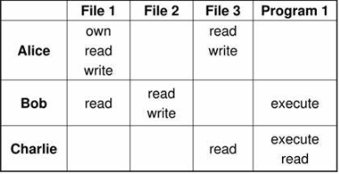
Example

Slide 33
Access matrices play a crucial role in access control mechanisms within operating systems, providing a structured approach to managing permissions and enforcing security policies.
Throughout this article, we have explored the concept of access matrices, their construction, and their impact on system security.
Access matrices provide a concise representation of the permissions granted to subjects (users, processes, or entities) to access objects (files, resources, or data) within an operating system.
By using rows to represent subjects and columns to represent objects, access matrices allow for fine-grained control over resource access.
Conclusion (AM)

Slide 34

System Threats:
System threats are described as the misuse of system services and network connections to cause user problems. These threats may be used to trigger the program threats over an entire network, known as program attacks. System threats make an environment in which OS resources and user files may be misused.
System and Network Threats

Slide 35
There are various system threats. Some of them are as follows:
1. Port Scanning: It is a method by which the cracker determines the system's vulnerabilities for an attack. It is a fully automated process that includes connecting to a specific port via TCP/IP. To protect the attacker's identity, port scanning attacks are launched through Zombie Systems, which previously independent systems now serve their owners while being utilized for such terrible purposes.
2. Worm: The worm is a process that can choke a system's performance by exhausting all system resources. A Worm process makes several clones, each consuming system resources and preventing all other processes from getting essential resources. Worm processes can even bring a network to a halt.
3. Denial of Service(DOS): Denial of service attacks usually prevents users from legitimately using the system. For example, if a denial-of-service attack is executed against the browser's content settings, a user may be unable to access the internet.
System and Network Threats

Slide 36
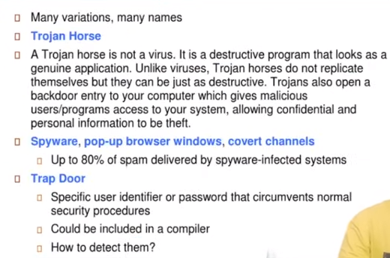
System and Network Threats

Slide 37
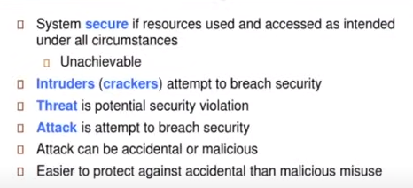
Security Problems

Slide 38

Attack: An attempt to break security and make unauthorized use of an asset.
Types:
Active : An active attack attempts to alter system resources or affect their operations. Active attack involve some modification of the data stream or creation of false statement.
Passive: A Passive attack attempts to learn or make use of information from the system but does not affect system resources. Passive Attacks are in the nature of eavesdropping on or monitoring of transmission. The goal of the opponent is to obtain information is being transmitted.
Attacks

Slide 39
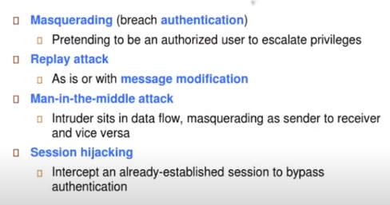
Examples of Attacks

Slide 40
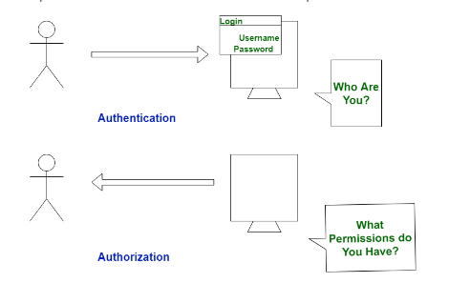
Authentication VS Authorization

Slide 41
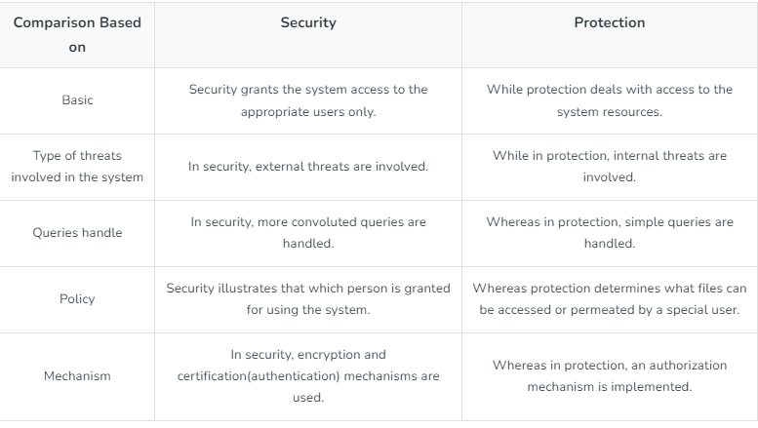
Security VS Protection

Slide 42
Reference
OPERATING SYSTEM CONCEPTS by ABRAHAM SILBERSCHATZ, PETER B. GALVIN, GERG GAGNE, WILEY
DESIGN OF THE UNIX OPERATING SYSTEM by MAURICE J. BACH, Pearson Education India
REAL-TIME SYSTEMS by JANE W. S. LIU, Pearson Education India
Operating System Security – javatpoint
https://dextutor.com/operating-system services/#:~:text=Protection%20and%20Security,deploy%20different%20tools%20from%20these.
What is a Security Vulnerability? (Definition, Types, and Remediation) (itsasap.com)

Slide 43

Thank you

